Slide 1
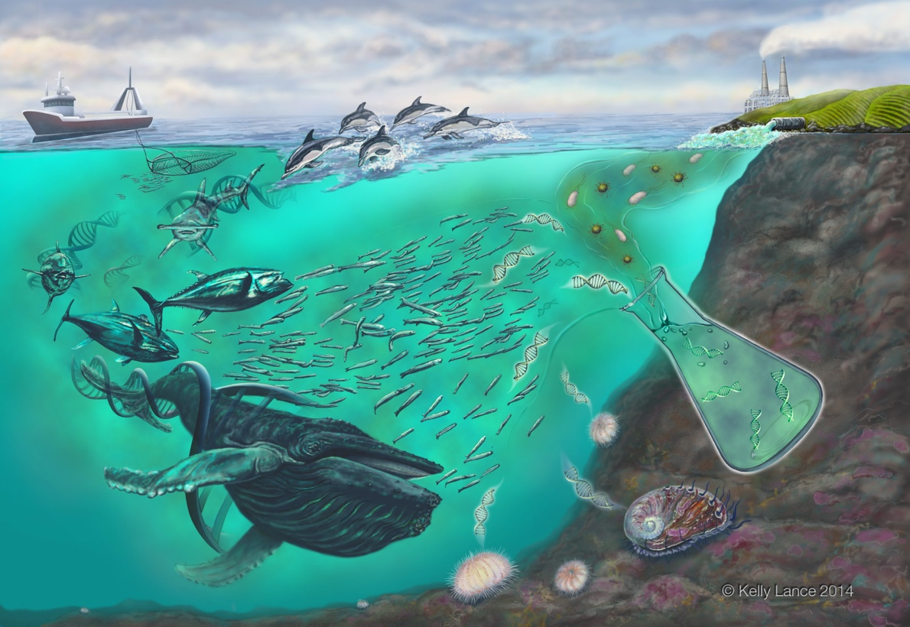

Emerging Science at the Intersection of Ecology, Genetics, and Policy
Ryan Kelly, JD, PhD
School of Marine and Environmental Affairs
University of Washington
UW SAFS
May 29, 2014

Slide 2
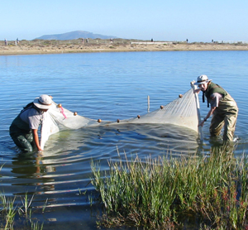
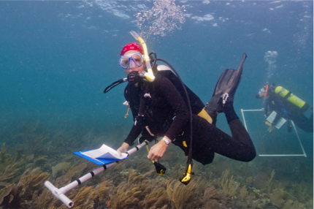
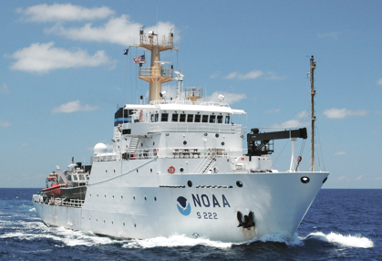
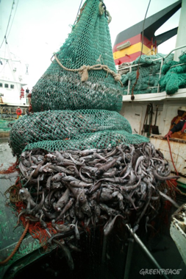
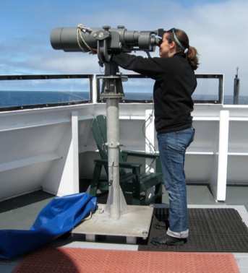
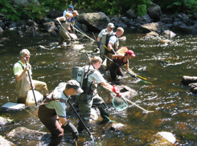
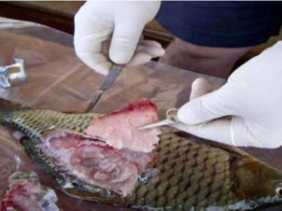
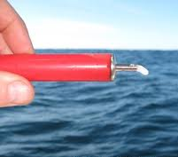
Conventional biological sampling
Notes:
-Conventional methods to monitor aquatic ecosystems are time intensive, costly and can be invasive.
-These include different forms of in situ observation, including net fishing, trawls, hook and line, dive surveys, sightings, ship-time, assaying and even destructive techniques
-We are exploring new approaches by which to observe the ocean in a way that meets these challenges.

Slide 3

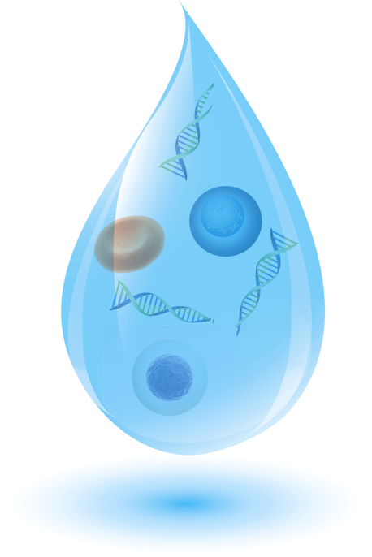
The Ocean is a Soup of Information
Tissue
Skin and scales
Free DNA /
RNA / Proteins
Metabolic waste
Notes:
-Environmental DNA, or eDNA, is sourced from metabolic waste, shed skin cells, or in some cases free DNA that has been cast off by an organism into its surrounding environment. -
-Sampling this environmental DNA (eDNA) is a potentially powerful means of assessing whole biological communities.

Slide 4
Relevant ‘omics
DNA → RNA → Protein
Genomics
Transcriptomics
Proteomics
What genes are present?
What genes are expressed?
What proteins are produced?

Slide 5
DNA
Genomics
Diagnostic
Which species are present/absent?
Which species characterize “good” vs. “bad” habitats?
Where/when does a species congregate?
[Where is most of a species’ biomass?]
Functional
Are genetic pathways in place to fix carbon?
Are complementary / competitive functions present?
What genes are present?

Slide 6
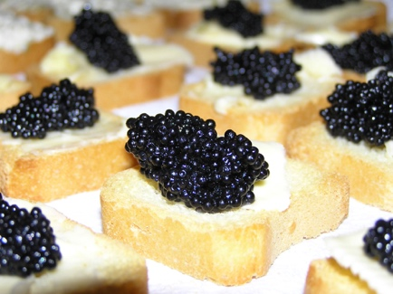
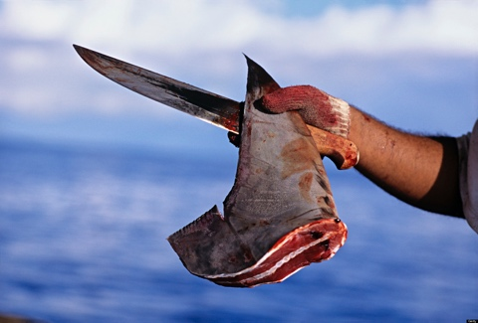

DNA as a Sampling Tool
Not a new idea
Conservation and Monitoring Applications
Microbe hunting
Purcell, Mackey, LaHood, Huber, and Park
Notes:
Waples and others have focused on using DNA for conservation/management purposes: identifying individuals, population parameters, etc.

Slide 7
Two eDNA techniques
Quantitative PCR (qPCR)
One species at a time
Quantitative
Sequencing
Hundreds/thousands of taxa at a time
Less quantitative

Slide 8
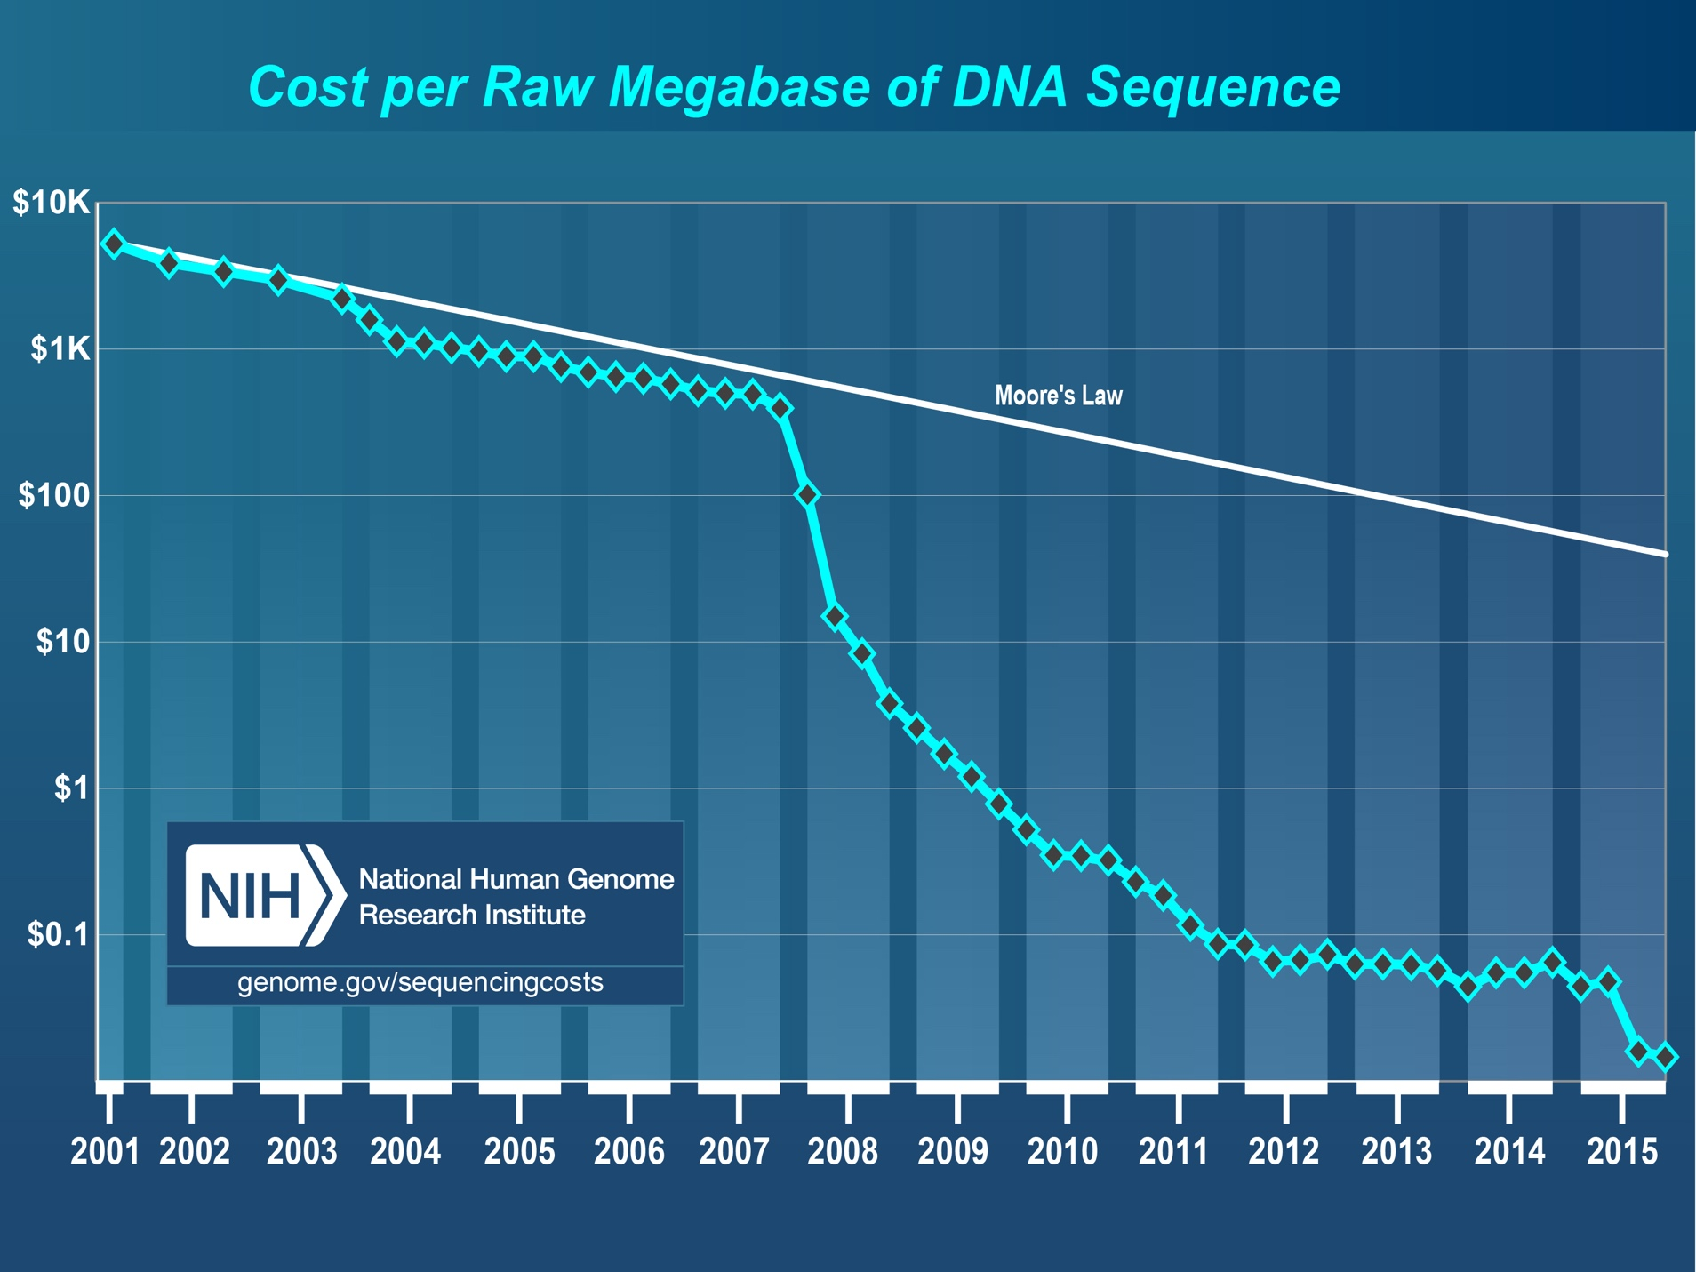
Sequencing costs

Slide 9
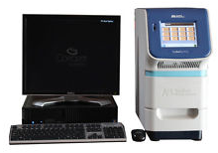
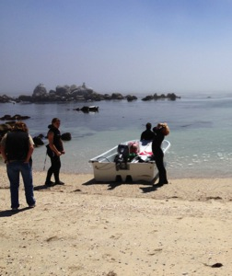
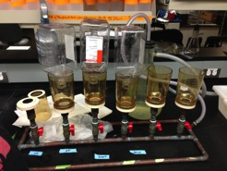
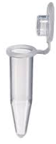
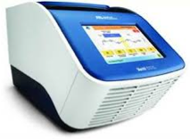
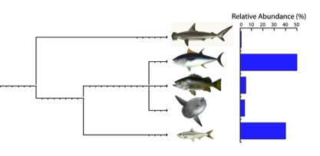
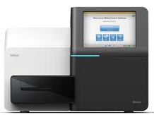
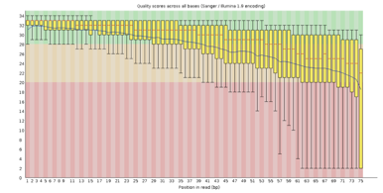
eDNA workflow
qPCR
DNA extraction
PCR
Water sampling
Water filtration
Taxonomic annotation
Bioinformatics
Sequencing
Notes:
-So what does an eDNA study look like?
-It starts in the field with water sampling (and any supplemental validation techniques), we collect 1-liter water samples.
-Samples are then filtered to capture a desired size fraction, followed by extracting the DNA from the filters.
-The target gene of interest is then amplified with PCR to generate millions of copies of that one gene, and then these amplicons as we call them are prepped for sequencing and then sequenced so that we can determine the taxonomic identity of the amplicon.

Slide 10
Targeting organisms in mixed samples
A tweezer / photocopier
Bacteria
PCR amplification using taxon-specific primers
Selects target gene of interest
from species of interest
Algae
Vertebrates
Vertebrates
Invertebrates
Community DNA
Vertebrate DNA
Notes:
To illustrate this, the tube on the left is the DNA extract from a seawater sample.
--In this extract are many different groups, including bacteria, algae, vertebrates, and invertebrates, with a strong bias towards bacteria and algae as these dominate a seawater
sample.
--If we’re interested in only pulling out the very small fraction of vertebrate DNA in the sample, we need to design vertebrate specific primers and barcodes so that after the PCR step we are left with the tube on the right.

Slide 11
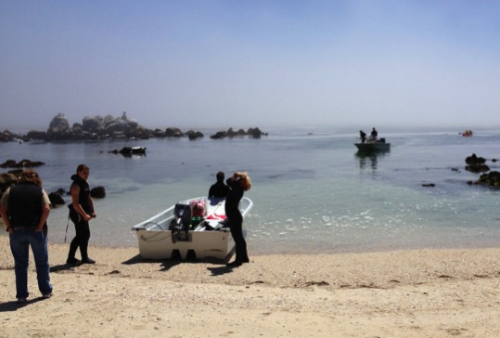
Does eDNA provide a benefit that we can’t get elsewhere?
qPCR: 1. vastly improved detection of rare targets
2. rapid quantification
Amplicon sequencing: alleviates depth/breadth tradeoff
Notes:
It is incredible that I can get starfish, birds of prey, surfperch, copepods, and porpoise out of the same glass of water. But we already knew those things were living in Puget Sound. Does eDNA provide a benefit that we can’t get elsewhere? It is uniquely valuable, and does it speak to questions that are already being asked?
Coming at the policy question from a legal background: what do existing laws/regs demand? If we can speak to those demands, uptake is quick.
Try to avoid classic science-policy interaction, in which scientists try and hand policymakers something they didn’t ask for.
Provides answers not otherwise easily attainable. So, yes: likely to be valuable.
And remarkably, a lot of the high-profile eukaryotic eDNA work done to date had explicit policy aims. Many examples of collaborating with the target audiences (agencies) to develop relevant techniques and ensure relevance.

Slide 12
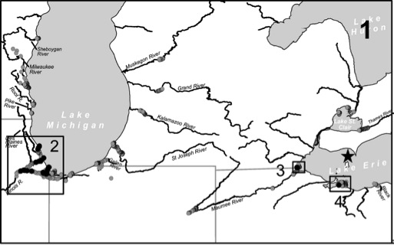
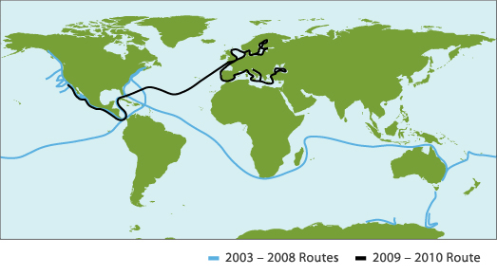
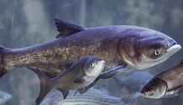
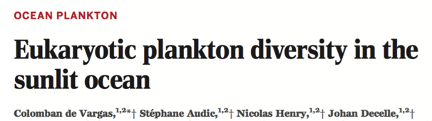
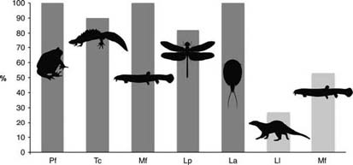
Some examples
qPCR
Sequencing
Invasive species
Plankton and Microbial diversity
Rusch et al. 2007 PLoS Biol 5:e77
Jerde et al. 2013, Can J Fish Aquatic Sci 70:522-526
Endangered species
Community Surveys
Port et al. 2016
Thomsen et al. 2012, Mol Ecol 21:2565-2573
Notes:
-eDNA has already been shown to be a effective tool for a number of applications.
-eDNA (in the form of complete bacterial cells) has been used for quite some time now by environmental microbiologists to survey microbial diversity and bacterial structure in the oceans (e.g. Global Ocean Sampling Expedition).
--Microbial eDNA approaches are well-vetted.
-On the other hand, only recently has eDNA been applied to multicellular life and higher organisms such as fish and mammals.
-Early work has used eDNA to track invasive species in freshwater systems, including the Asian carp in the Great Lakes
-eDNA has also been used to determine the distribution of endangered and rare species in freshwater systems.
-One of the applications we’re interested in at COS is the use of eDNA to monitor biodiversity levels and species distribution in MPAs.
Fig. 2 Environmental DNA detection rates by qPCR in natural freshwater ponds with 100% occurrence of the species confirmed in the field (dark grey) or larger freshwater systems with known occurrence in the area (light grey). Detection rates are given in percentage positive localities out of the total number of localities surveyed for each species. Data covers amphibians: Pf (Pelobates fuscus, n = 9) and Tc (Triturus cristatus, n = 11); fish: Mf (Misgurnus fossilis, n = 11 ponds and n = 15 streams—light grey); insects: Lp (Leucorrhinia pectoralis, n = 11); crustaceans: La (Lepidurus apus, n = 10) and mammals: Ll (Lutra lutra, n = 15 streams and lakes).

Slide 13
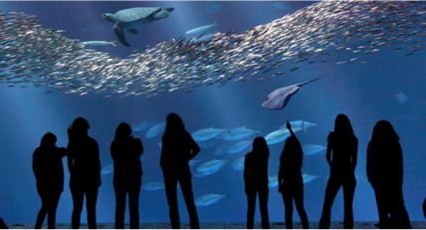
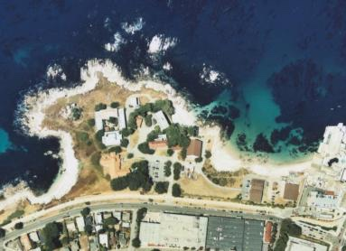
Sequencing Validation Studies
Known community: Monterey Bay Aquarium
Field surveys: eDNA vs. Visual Counts
Does eDNA vary predictably across marine habitats?
Do eDNA results match fish survey data?
Notes:
-We are conducting validation studies in both controlled and field settings.
-We used the Open Sea Tank here at the MB Aquarium as a mesocosm to determine whether we can reconstruct the known vertebrate composition of the tank using eDNA.
--The tank allowed us to get at false positive and false negative detection rates, information that is strongly needed for the field.
-We are also doing field tests in Monterey Bay, at the Marine Life Observatory at Hopkins and offshore at MBARI moorings.
--We want to know whether the eDNA profile varies across habitats and if the results match fish survey data.

Slide 14
Field eDNA Take-Home

Slide 15
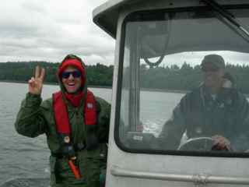
Recent / Ongoing Examples
qPCR
Counting fish in Skagit Bay (O’Donnell et al. with NMFS)
Counting sockeye salmon in Hansen Creek, Alaska (Tillotson et al.)
Amplicon Sequencing
Urbanization’s effect on nearshore communities (with NMFS)
Community-level ocean acidification effects
Halo effect for eelgrass(?)

Slide 16
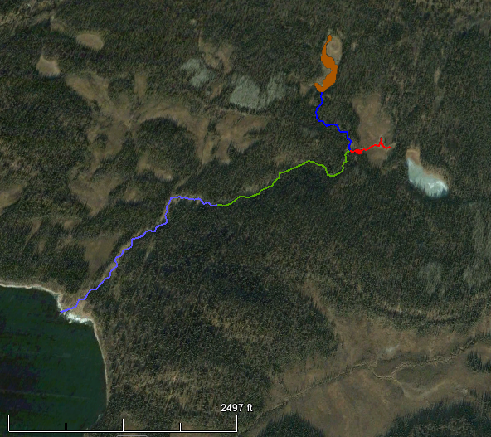
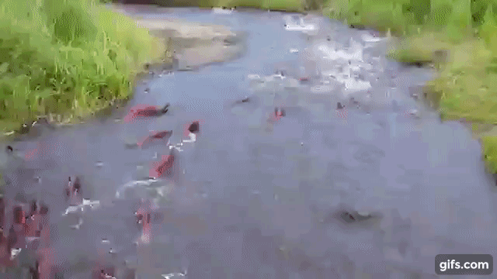
qPCR: Sockeye Salmon in Alaska
Hansen Creek, Alaska
Lower
Site D
Site B
Middle
Site C
Pond
Site A
Mike Tillotson et al. (Biol. Conserv. 2018)

Slide 17
qPCR: Sockeye Salmon in Alaska
Lower
Site D
Site B
Middle
Site C
Pond
Site A
Mike Tillotson et al. (Biol. Conserv. 2018)
1. Good quantitative relationship. 2. Interesting time-lag. 3. Rapid degradation over space.

Slide 18
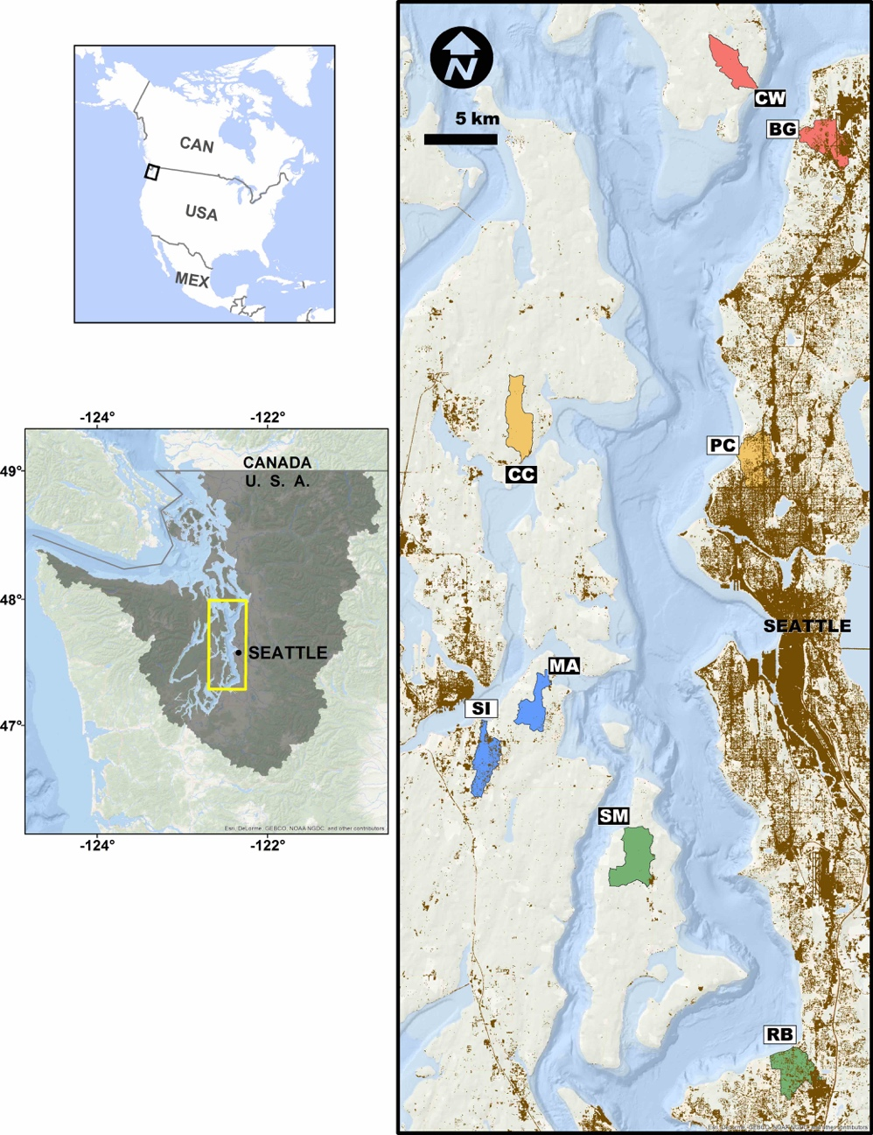
Sequencing: How does upland urbanization affect nearshore communities?
8 Paired Sites (4 pairs)
controlled for latitude, watershed size
watershed impervious surface cover
1-8% vs. 25-42%
Nearshore eelgrass habitats
3 water samples / site (i.e., transects)
4 PCR replicates / sample
Custom 16s mtDNA primers
Just animals (Metazoa)
ca. 116bp
ca. 200,000 reads/replicate
Kelly et al. PeerJ 2016

Slide 19
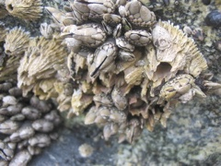
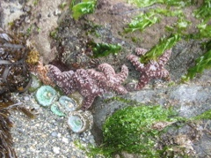
How does upland urbanization affect nearshore communities?
215 taxa annotated, 135 annotated to Family
Bryozoa
Echino.
Entopr.
Porifera
Hemich.
Nemertea
Arthropoda
Chordata
Mollusca

Slide 20
How does upland urbanization affect nearshore communities?
More-urban sites are more homogeneous
Notes:
Beta variance is among 1000 rarefaction replicates.
(Not shown: site-site differences are equally large among urban sites as among less-urban sites)
More-urban sites support a fauna that is
Richer
More homogeneous across transects (within sites)
Just as heterogeneous across sites
More heavily infaunal, sessile
… than less-urban sites. Strong land-sea interactions.
Policy relevance: shoreline armoring, impervious surface cover, etc. Existing areas of interest in state, addresses question of spatial scale (small, probably) relevant to land-use planning. But no immediate rulemaking pending, e.g.

Slide 21
eDNA for Policy Application
qPCR
Efficient detection
Rapid quantitative assessment
Details likely matter (temperature, flow rate, etc)
Amplicon Sequencing
Eases depth/breadth tradeoff, but:
Different sampling techniques inevitably yield different results
No method surveys whole community
Notes:
[link to demand-driven, co-produced theme]

Slide 22
Current OA Study (results TBD)

Slide 23
Significant law/policy application
Invasive species detection (NISA)
Endangered Species Act (ESA)
Ecological context, associations
Water Quality (CWA)
Community-level assessment; indicator spp.
Stormwater impacts?
Status and trends of the Sound
NEPA and cumulative impacts?

Slide 24
Thanks
Ramón Gallego
Emily Jacobs-Palmer
Kelly Cribari
Jimmy O’Donnell
Jimmy Kralj
Mike Tillotson
Natalie Lowell
Ole Shelton
Jameal Samhouri
Greg Williams
Blake Feist
Linda Park
AND
Packard Foundation, Stanford (Boehm lab and Center for Ocean Solutions), UW CEG (Armbrust, Morris, Rocap labs), Phil Levin, USGS (Jeff Duda, Marshall Hoy), WA DNR

